Slide 1
3D PRINTER MATERIAL
PREDICTION
S.AISWARIYA
G.ANNAPOORANI
J.JENISHA
A.SOWMYA

Slide 2
PROBLEM STATEMENT:
The aim of the study is to determine the best material which will be perfect for the given use case. Where there are eleven setting parameters and one output parameters. Based on these input parameters we have to predict the best material for model.

Slide 3
DATA COLLECTION:
For the given problem statement 3D material prediction from
Kaggle.
INPUT PARAMETERS:
Layer Height (mm)
Wall Thickness (mm)
Infill Density (%)
Infill Pattern (honey comb, grid)
Nozzle Temperature (Cº)
Bed Temperature (Cº)
Print Speed (mm/s)
Fan Speed (%),
Roughness (μm)
OUTPUT PARAMETERS:
MATERIAL TO BE USED.

Slide 4
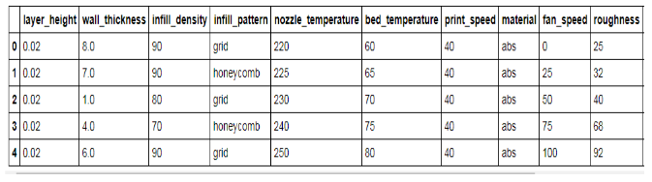

Slide 5
DECISION TREE:
It is a classification algorithm.
It comes under the category of supervised learning.
Here we have separate training and testing data.
It is one of the predictive modeling approaches used
in statistics, data mining and machine learning

Slide 6
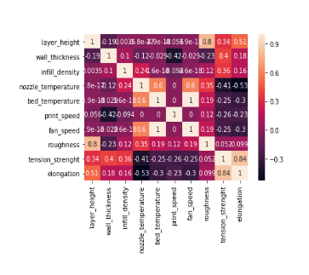
HEAT MAP:

Slide 7
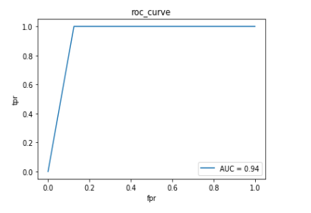
ROC CURVE:

Slide 8
ACCURACY SCORE:
from sklearn.metrics import accuracy_score
accuracy_score(y_test,y_pred_dt)
O/P:
0.9285714285714286

